Slide 1
Selma to Montgomery marches
From Wikipedia, the free encyclopedia
https://en.wikipedia.org/wiki/Selma%20to%20Montgomery%20marches
Licensed under CC BY-SA 3.0:
https://en.wikipedia.org/wiki/Wikipedia:Text_of_Creative_Commons_Attribution-ShareAlike_3.0_Unported_License

Slide 2
Selma to Montgomery marches
To defuse and refocus the community's outrage, SCLC Director of Direct Action James Bevel, who was directing SCLC's Selma voting rights movement, called for a march of dramatic length, from Selma to the state capital of Montgomery.
The third march started March 21.
The marchers arrived in Montgomery on March 24 and at the Alabama State Capitol on March 25.
The route is memorialized as the "Selma To Montgomery Voting Rights Trail", and is designated as a U.S. National Historic Trail.

Slide 3
Selma movement established: 1963–1964
The Society of Saint Edmund, an order of Catholics committed to alleviating poverty and promoting civil rights, were the only whites in Selma who openly supported the voting rights campaign.
This injunction made it illegal for more than two people at a time to talk about civil rights or voter registration in Selma, suppressing public civil rights activity there for the next six months.

Slide 4
Background
With civil rights activity blocked by Judge Hare's injunction, Frederick Douglas Reese requested the assistance of King and the Southern Christian Leadership Conference (SCLC).
King and the executive board of SCLC had not joined it.
SNCC called in Fay Bellamy and Silas Norman to be full-time organizers in Selma.

Slide 5
Events of January
The Selma Voting Rights Campaign officially started on January 2, 1965, when King addressed a mass meeting in Brown Chapel A.M.E. Church in defiance of the anti-meeting injunction.
On January 15, King called President Johnson and the two agreed to begin a major push for voting rights legislation which would assist in advancing the passage of more anti-poverty legislation.
On January 20, President Johnson gave his inaugural address, but did not mention voting rights.

Slide 6
Events of February
Throughout that February, King, SCLC staff, and members of Congress met for strategy sessions at the Selma, Alabama home of Richie Jean Jackson.
In addition to actions in Selma, marches and other protests in support of voting rights were held in neighboring Perry, Wilcox, Marengo, Greene, and Hale counties.
Selma students organized themselves after the SCLC leaders were arrested.

Slide 7
Jimmie Lee Jackson's death
On February 18, 1965, C. T. Vivian led a march to the courthouse in Marion, the county seat of neighboring Perry County, to protest the arrest of James Orange.
State officials had received orders to target Vivian, and a line of Alabama state troopers waited for the marchers at the Perry County courthouse.

Slide 8
Initiation and goals of the march
James Bevel, as director of the Selma voting rights movement for SCLC, called for a march from Selma to Montgomery to talk to Governor George Wallace directly about Jackson's death, and to ask him if he had ordered the State Troopers to turn off the lights and attack the marchers.
Dr. King agreed with Bevel's plan of the march, which they both intended to symbolize a march for full voting rights.
"There will be no march between Selma and Montgomery," Wallace said on March 6, 1965, citing concern over traffic violations.

Slide 9
"Bloody Sunday" events
On March 7, 1965, an estimated 525 to 600 civil rights marchers headed southeast out of Selma on U.S. Highway 80.
The march was led by John Lewis of SNCC and the Reverend Hosea Williams of SCLC, followed by Bob Mants of SNCC and Albert Turner of SCLC.
Televised images of the brutal attack presented Americans and international audiences with horrifying images of marchers left bloodied and severely injured, and roused support for the Selma Voting Rights Campaign.

Slide 10
Response to "Bloody Sunday"
After the march, President Johnson issued an immediate statement "deploring the brutality with which a number of Negro citizens of Alabama were treated".
He also promised to send a voting rights bill to Congress that week, although it took him until March 15.
SNCC officially joined the Selma campaign, putting aside their qualms about SCLC's tactics in order to rally for "the fundamental right of protest".

Slide 11
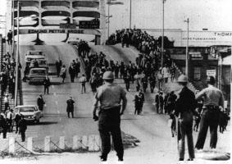
Police watch marchers turn around on Tuesday, March 9, 1965.

Slide 12
Second march: "Turnaround Tuesday"
Bevel, King, Nash, and others began organizing a second march to be held on Tuesday, March 9, 1965.
Awakened to issues of civil and voting rights by years of Civil Rights Movement activities, and shocked by the television images of "Bloody Sunday," hundreds of people responded to SCLC's call.
King asked them to remain in Selma for another march to take place after the injunction was lifted.

Slide 13
Response to the second march
President Johnson called Reeb's widow and father to express his condolences (he would later invoke Reeb's memory when he delivered a draft of the Voting Rights Act to Congress).
Dr. King's credibility in the movement was shaken by the secret turnaround agreement.
Criticism of King by radicals in the movement became increasingly pronounced, with James Forman calling Turnaround Tuesday, "a classic example of trickery against the people".

Slide 14
Actions in Montgomery
They were quickly joined by James Forman and much of the SNCC staff from Selma.
On March 11, SNCC began a series of demonstrations in Montgomery, and put out a national call for others to join them.
Although Dr. King was concerned by Forman's violent rhetoric, he joined him in leading a march of 2000 people in Montgomery to the Montgomery County courthouse.

Slide 15
Actions at the White House
On March 12, President Johnson had an unusually belligerent meeting with a group of civil rights advocates including Bishop Paul Moore, Reverend Robert Spike, and SNCC representative H. Rap Brown.
He also began preparing the final draft of his voting rights bill.
He would use an 1870 civil rights law as the basis for charges.

Slide 16
Johnson's decision and the Voting Rights Act
On March 15, the president convened a joint session of Congress, outlined his new voting rights bill, and demanded that they pass it.
Johnson added that his entire Great Society program, not only the Voting Rights Bill, was part of the Civil Rights Movement.
Johnson's Voting Rights Bill was formally introduced in Congress two days later.

Slide 17
March to Montgomery
To ensure that this march would not be as unsuccessful as the first two marches were, the president federalized the Alabama National Guard on March 20 to escort the march from Selma, The ground operation was supervised by Deputy US Attorney General Ramsey Clark.
On the morning of March 24, the march crossed into Montgomery County and the highway widened again to four lanes.

Slide 18
Response to the third march
The third Selma march received national and international coverage.
Gaining more widespread support from other civil rights organizations in the area, this third march was considered an overall success, with greater degree of influence on the public.

Slide 19
Hammermill boycott
During 1965, Martin Luther King was promoting an economic boycott of Alabama products to put pressure on the State to integrate schools and employment.
In cooperation with SCLC, student members of Oberlin College Action for Civil Rights, joined with SCLC members to conduct picketing and a sit-in at Hammermill's Erie, Pennsylvania headquarters.

Slide 20
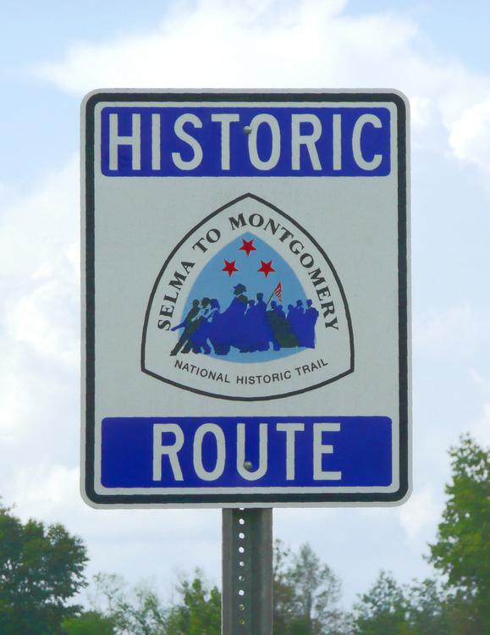
Selma to Montgomery National Historic Trail sign

Slide 21
Aftermath and historical impact
Johnson's televised speech before Congress was carried nationally; it was considered to be a watershed moment for the civil rights movement.
Many in the Civil Rights Movement cheered the speech and were emotionally moved that after so long, and so hard a struggle, a President was finally willing to defend voting rights for blacks.

Slide 22
Legacy and honors
As part of the National Historic Trail, the National Park Service operates two interpretive centers (Selma and Lowndes County).
It is planning to operate a Montgomery center to be located on the campus of Alabama State University.
In a later ceremony, two dozen individuals in Selma received certificates.
Barack Obama signed the resolution in law on March 7.

Slide 23
Commemorative marches
In March 1975, Coretta Scott King, the widow of Martin Luther King Jr. led four thousand marchers commemorating Bloody Sunday.
An estimated 40,000 people attended to commemorate the 1965 march, and to reflect on and speak about its impact on history and continuing efforts to address and improve U.S. civil rights.

Slide 24
Revitalization
The Montgomery portion of the Selma to Montgomery trail was being improved through a multimillion-dollar investment in order to enhance the trail and related neighborhoods.
Since 2010, federal teams have met with community leaders in Selma, Hayneville and Montgomery, the county seats of Dallas, Lowndes and Montgomery counties.

Slide 25
Representation in media
Selma, Lord, Selma (1999), the first dramatic feature film based on events surrounding the Selma to Montgomery marches, is a Disney made-for-TV movie shown on ABC television.
Selma, a 2014 American film directed by Ava DuVernay, features the historic figures who developed the voting rights campaign in Selma and led the Selma to Montgomery marches.

Slide 26
External links
"Selma, Lord, Selma: The Voting Rights Campaign".
Civil Rights Movement Veterans.
Civil Rights Movement Veterans.
Civil Rights Movement Veterans.
"Selma-to-Montgomery 1965 Voting Rights March".
"The Selma to Montgomery Voting Rights March: Shaking the Conscience of the Nation".National Park Service.
"March from Selma to Montgomery, Alabama, Commencing March 21, 1965".
"Selma to Montgomery March".
"The Selma March Remembered".

